Slide 1
Teaching, Poetry, Creativity

Slide 2
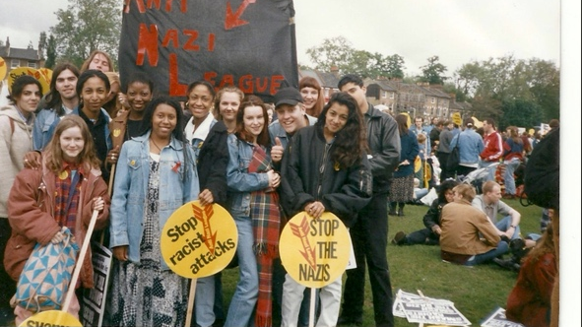
Notes:
Difference between ‘real’ and representation – shows re at 16

Slide 3
Pink Hummingbird for John Toolan
The postcard he sent you in that long wet summer
had, on one side, a pale pink hummingbird
and overleaf, his notes on your essay on Faulkner
in his usual turquoise ink; the words,
you imagined, written in sunlight on the bed
of his book-stuffed flat, each weighed with care
like a love letter, though it was you who wanted
him. All summer, you waited for September:
to be back in the tattered classroom,
the tables pushed together, and him at the top
like a doting father, or a bridegroom,
or like God, if God wore Doc Marten shoes
and a silver sleeper in one ear – not the God
you didn’t believe in, but one who believed in you.
Notes:
Importance of a good teacher. JT got us writing poetry

Slide 4
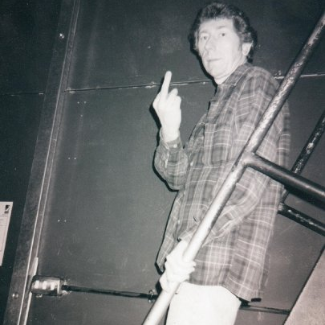

Slide 5
For Colored Girls Who Have Considered Suicide When the Rainbow is Enuf
Our vowels were flat as the dead fish that floated
in Dagenham Docks, but still John made us
recite these lines meant for black women who said
i have/ poems/ big thighs/ lil tits which made us blush
as our estuary tongues went tripping
over cuz and enuf, and the slashes the poet
scattered over her page. And the whole bloody thing
might well have been staged on another planet
compared to Essex and my pals, whose mums
served up school dinners, whose dads worked nights at Fords.
We could just make out the half-rubbed words
of last year’s kids – discourse, nationhood –
and soon I biro’ed in my own new terms:
hegemony, resistance, sisterhood.
Notes:
First book I really loved through formal education

Slide 6
Martin and Pam
Funny to learn it now, his first name: Martin,
so man-with-a-lawnmower suburban; so Sundays
in the aisles of B and Q. Not a name for the man
I remember, who stormed the wood-dark hallways
in Oxford robes that hid the muscle and meat
he let me know was there, the anger flexing
in his hands. He’d snap my name like a belt,
then slap the table so I felt the sting.
And Mrs Bradshaw’s name was Pamela
or Pam, as soft as tea and custard creams.
She’d make us run six miles in knickers and vests
her whistle rudely screaming over frost,
and afterwards she’d watch us in the showers
as we tried to hide our bodies in the steam.
Notes:
Problems of the tradition and

Slide 7
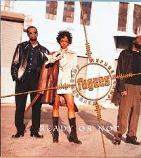
The Register
That first September, I climbed the blue stone steps,
past Shakespeare’s doubtful face, an old mosaic
of Jamaica, and the ruby blot of lips
where last year’s girls had kissed the schoolhouse brick.
Now this year’s crop pushed past, all clattery-chat,
their first-day back – Whassup? Salaam! – the Fugees
blaring from someone’s phone: Ready or not…
And with that old white dog still barking softly
in my head, I walked the sugar-papered hall
and pushed the classroom door to find a sprawl
of teenagers sat waiting, my ‘re-sitters’,
all back to do what they’d already failed.
I took my seat, and called the register
Deniz, Tyrone, Alicia, Chantelle –

Slide 8
Sonnet for the A level Literature and Language Poetry Syllabus
all summer term reading poems –
down in the mud
of words, wanting
the kids to hear what I heard –
breaking the poems apart, slapping
their parts to the board –
‘I would love ten years
before the flood’
‘The world is charged
with the grandeur of god’
‘Yet dearly I love you
and would be lov'd fain’
‘Batter my heart’
again, again.

Slide 9
Simile
Timothy Winters has ears like bombs and teeth like splinters…Charles Causley
I can’t remember when, or which old teacher
chalked Charles Causley’s words on the board and glued them
onto my brain, so whenever I need to remember
or explain what ‘simile’ is, I use that poem –
poor Timothy Winters with his meagre face
though really, all these years, it’s Bobbi, a girl
from school that I’ve been seeing. Bobbi, who’d chase
and kiss any boy with her ragged, gaping smile,
scuttling the asphalt in her too-small skirts
and a galaxy of moon-shaped plasters peeling
from her neck and shoulders. Nobody liked her.
But nowadays to think of Bobbi hurts
like an old fading bruise you keep on poking.
Bobbi Bonniwell? What happened to her.

Slide 10
The Only English Kid
When the debate got going on ‘Englishness’,
I’d pity the only English kid – poor Johnny
in his spotless Reeboks and blue Fred Perry.
He had a voice from history: Dunno-miss,
Yes-miss, No-miss – all treacly-cockney,
rag-and-bone – and while the others claimed Poland,
Ghana, Bulgaria, and shook off England
like the wrong team’s shirt, John brewed his tea
exclusively on Holloway Road. So when Aasif
mourned the George Cross banner swinging freely
like a warning from his neighbour’s roof,
the subway tunnel sprayed with MUSLIM SCUM,
poor John would sit there quietly, looking guilty
for all the awful things he hadn’t done.

Slide 11
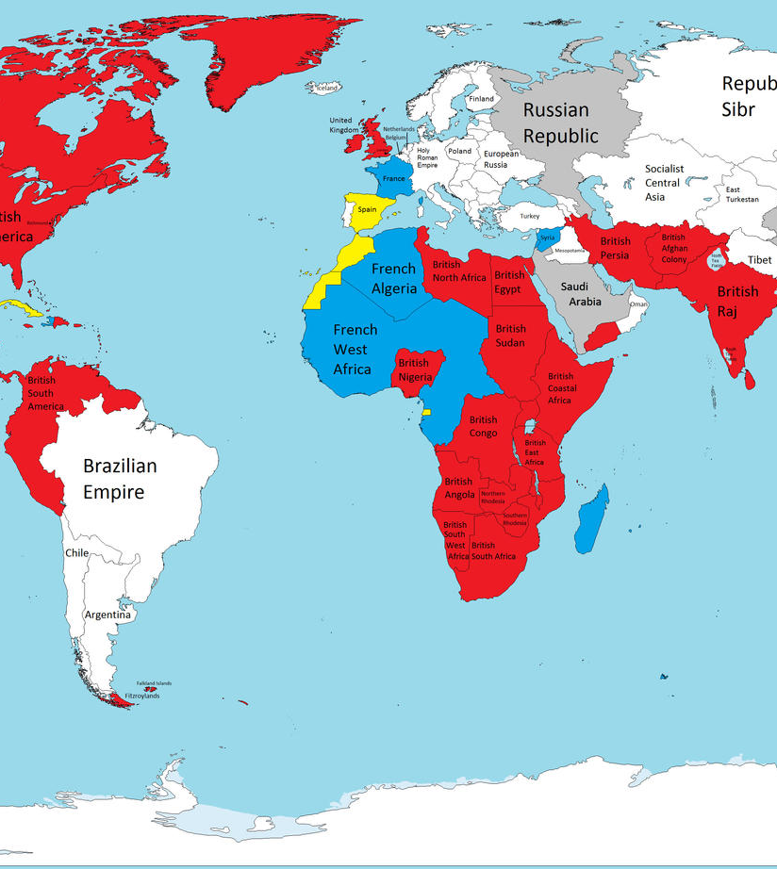
Technology
Suddenly computers,
screens, an electronic pen
so off the cuff,
I’d ping a poem up –
To Mercy, Pity, Peace and Love
or a drawing of the Pardoner,
an image of an ivory tusk
or a map –
one that showed
the ‘heyday’ of the British Empire,
the pale blue sea around
the places half those kids
had sort of come from once,
shaded rich and bloody red.

Slide 12
Sonnet for Boredom
Some days it’s all he talks of – Minecraft, Minecraft –
world I won’t set foot in: skeletons
and zombies, mooshrooms, lava? When he’s gone,
he’s gone for hours, and the iPad is a raft
he sails from breakfast to lunch on, lunch to dinner,
though I try to haul him in – the park in rain
or drawing, baking – nothing’s easier
than giving in. When I was six, my game
was boredom. Bored, lying on the floor
of my bedroom, hoping for the phone to ring,
unpicking stickers to stick them down again,
wishing for a tiny secret door
below the bed, for the curtain elves and gnomes
to stand on toadstools, whispering my name.

Slide 13
Kathy, Carla for Mimi Khalvati
The body is something like a poem, I guess,
as I watch my yoga teacher – Kathy –
on the back-row mat of Carla’s yoga class.
Kathy can do King Pigeon, Crow, Full Monkey –
yet here she is, in a simple forward bend
while Carla lays her palms around her core
to push her deeper. Can every pose be deepened,
I wonder? Can what’s been mastered be mastered more?
A poem is something like a body, I guess,
when I’m holding somebody else’s poem
in this sun-filled room they’ve called a ‘masterclass’.
But I’m not a master, just a pair of palms
which push or pull or loosen someone’s lines –
I still need kind and guiding hands on mine.

