Slide 1



The Science of
Motivation
Peps Mccrea
@pepsmccrea

Slide 2


Slide 3
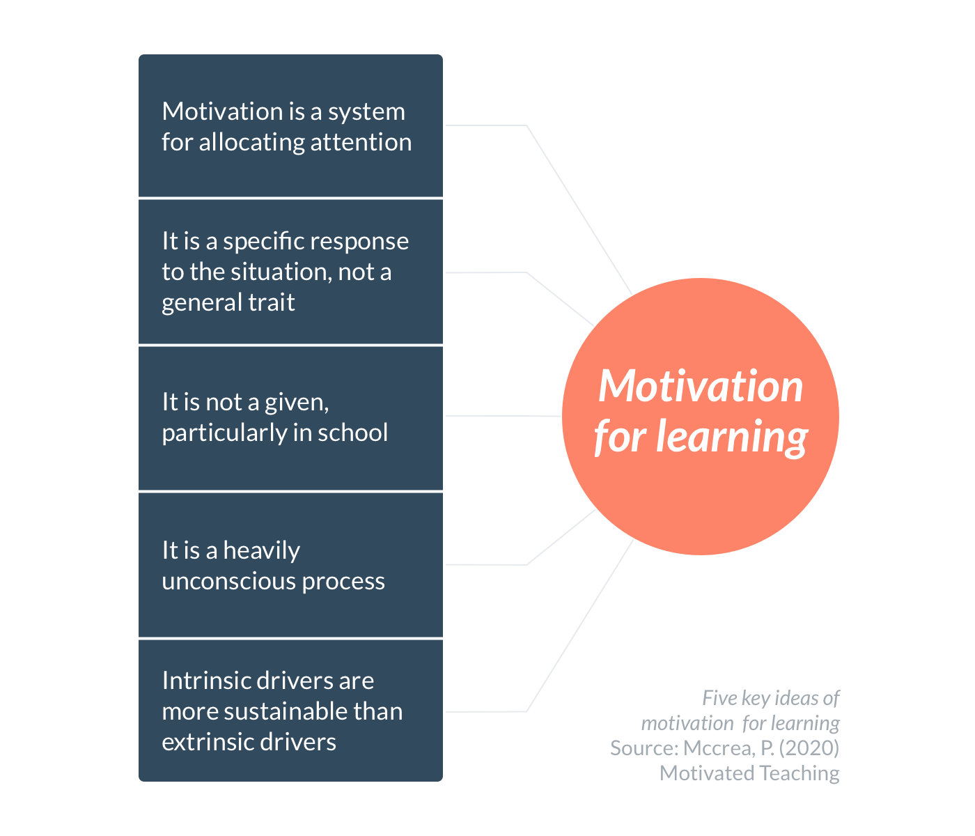

Slide 4
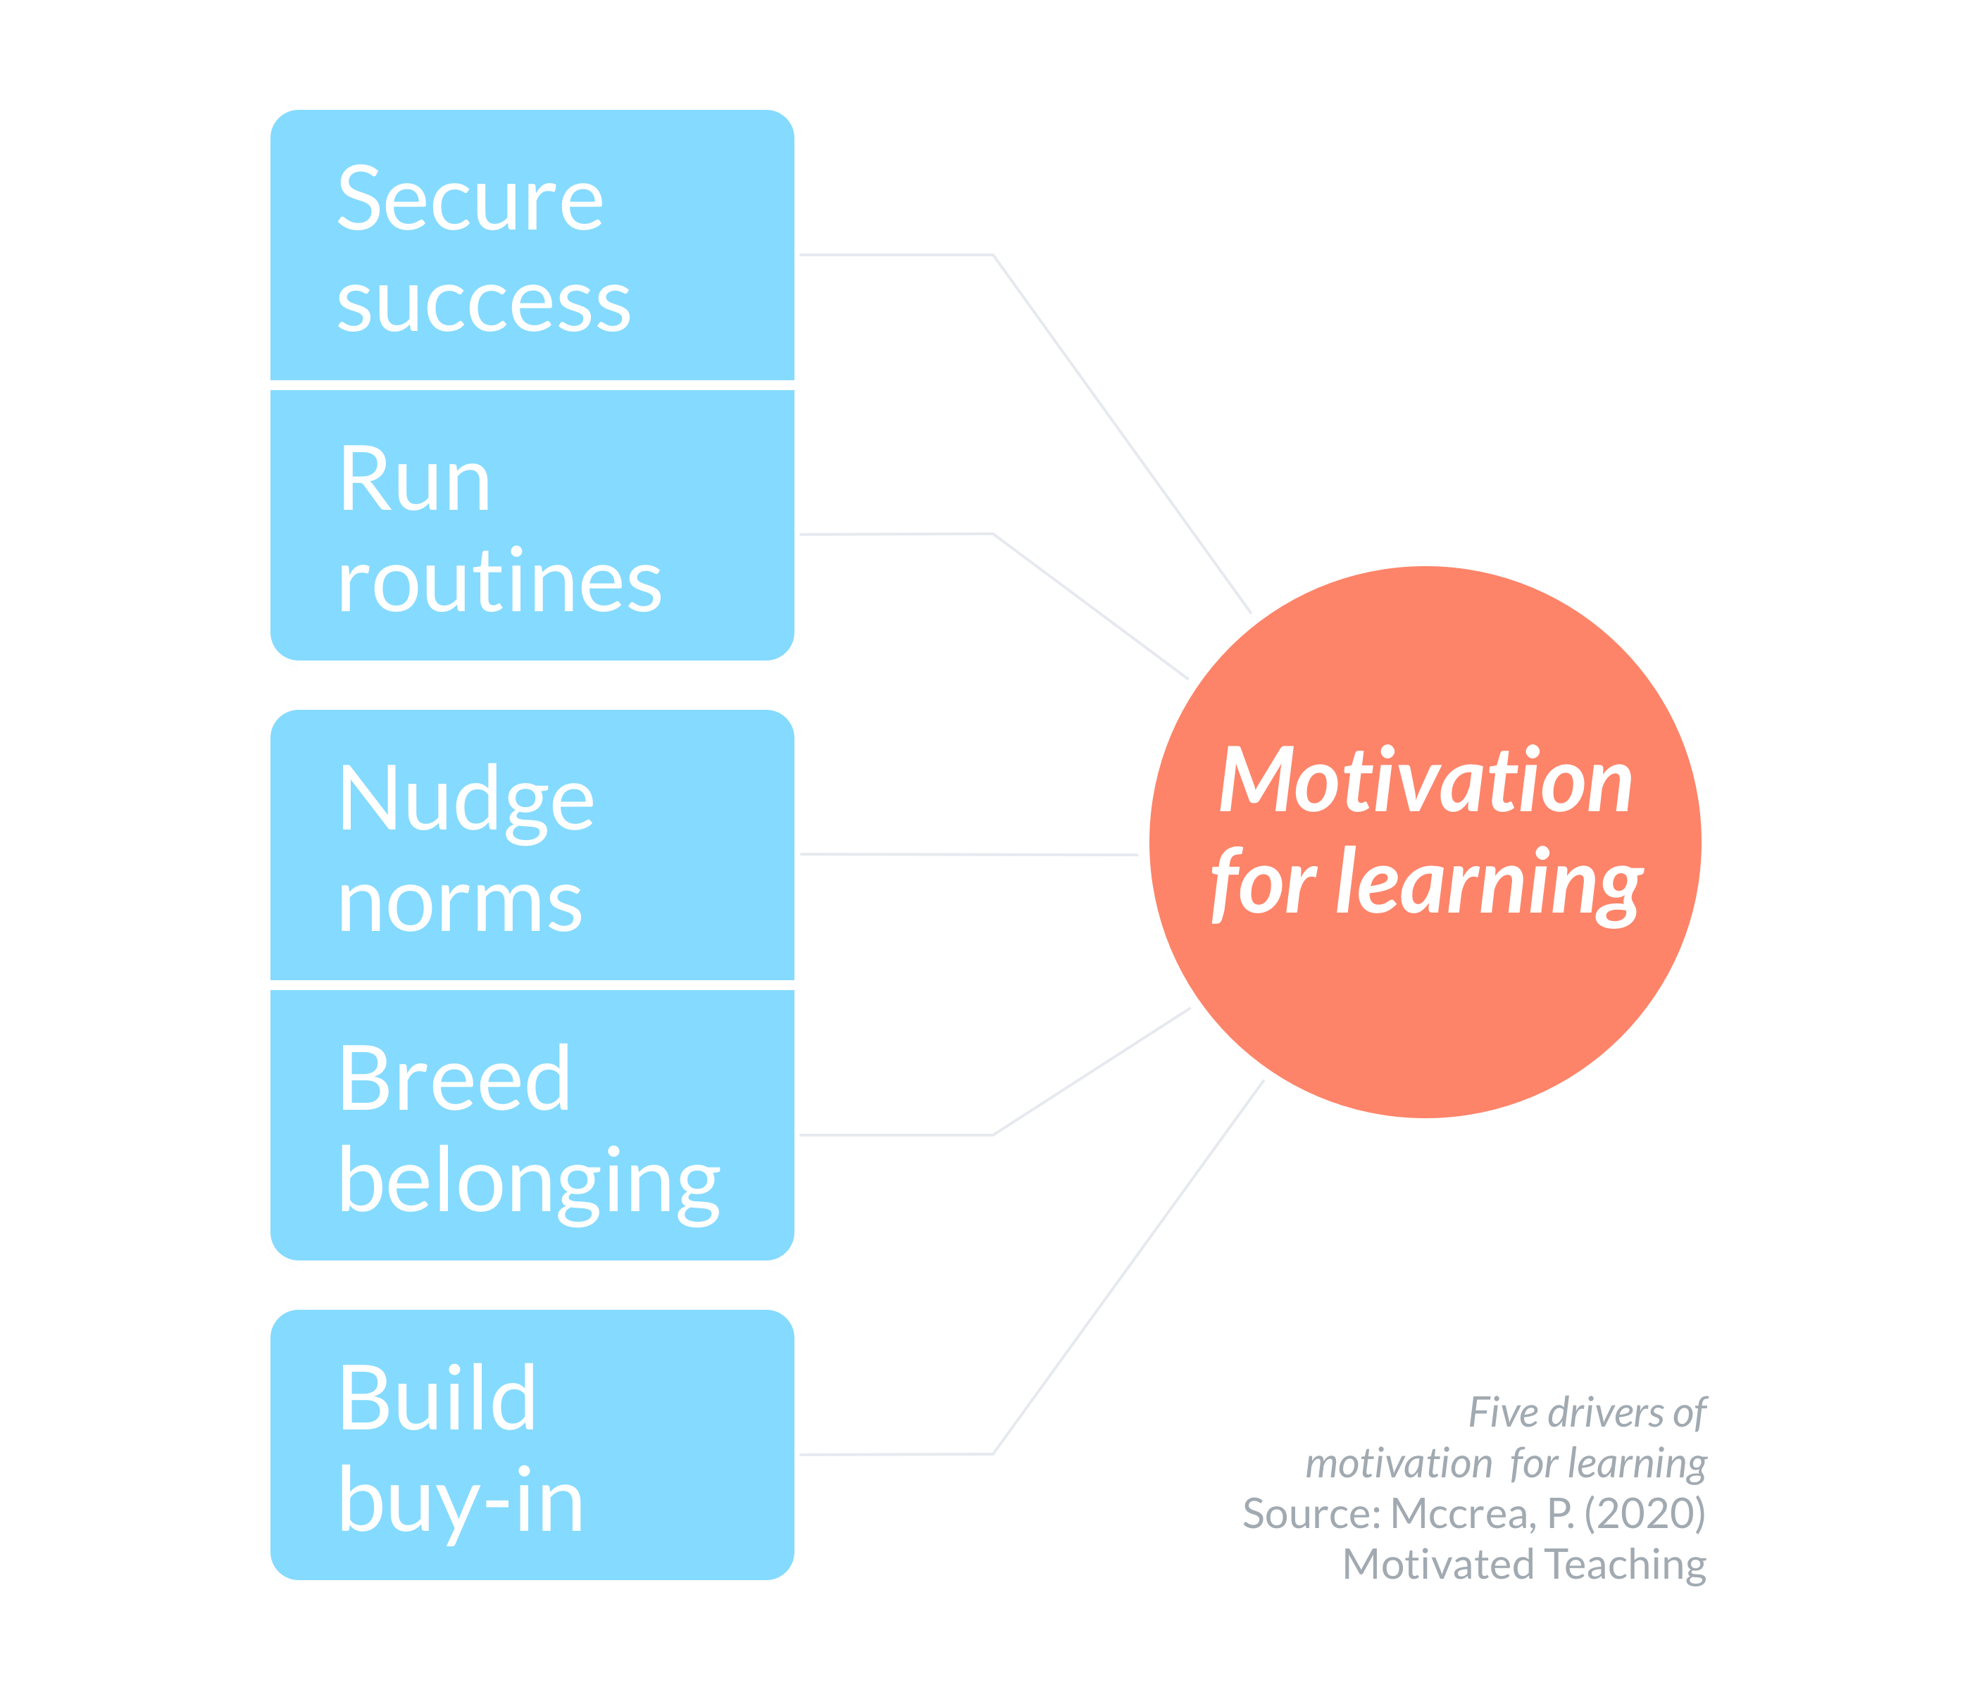

Slide 5
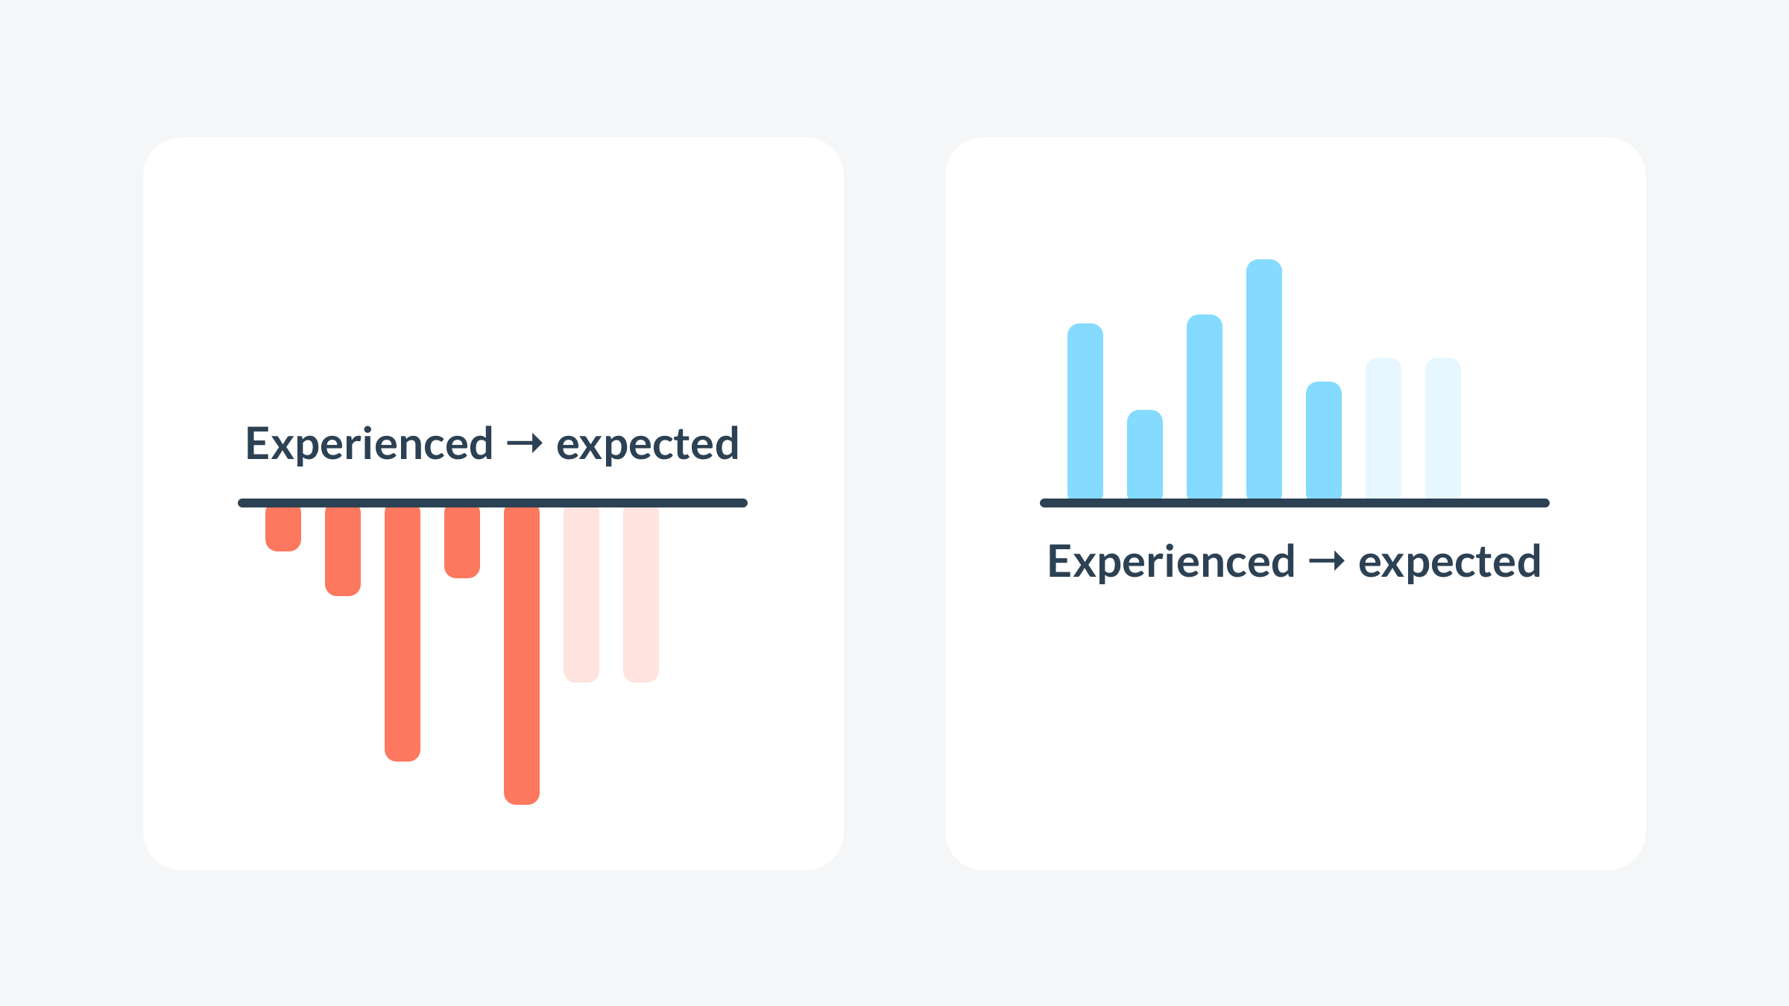

Slide 7
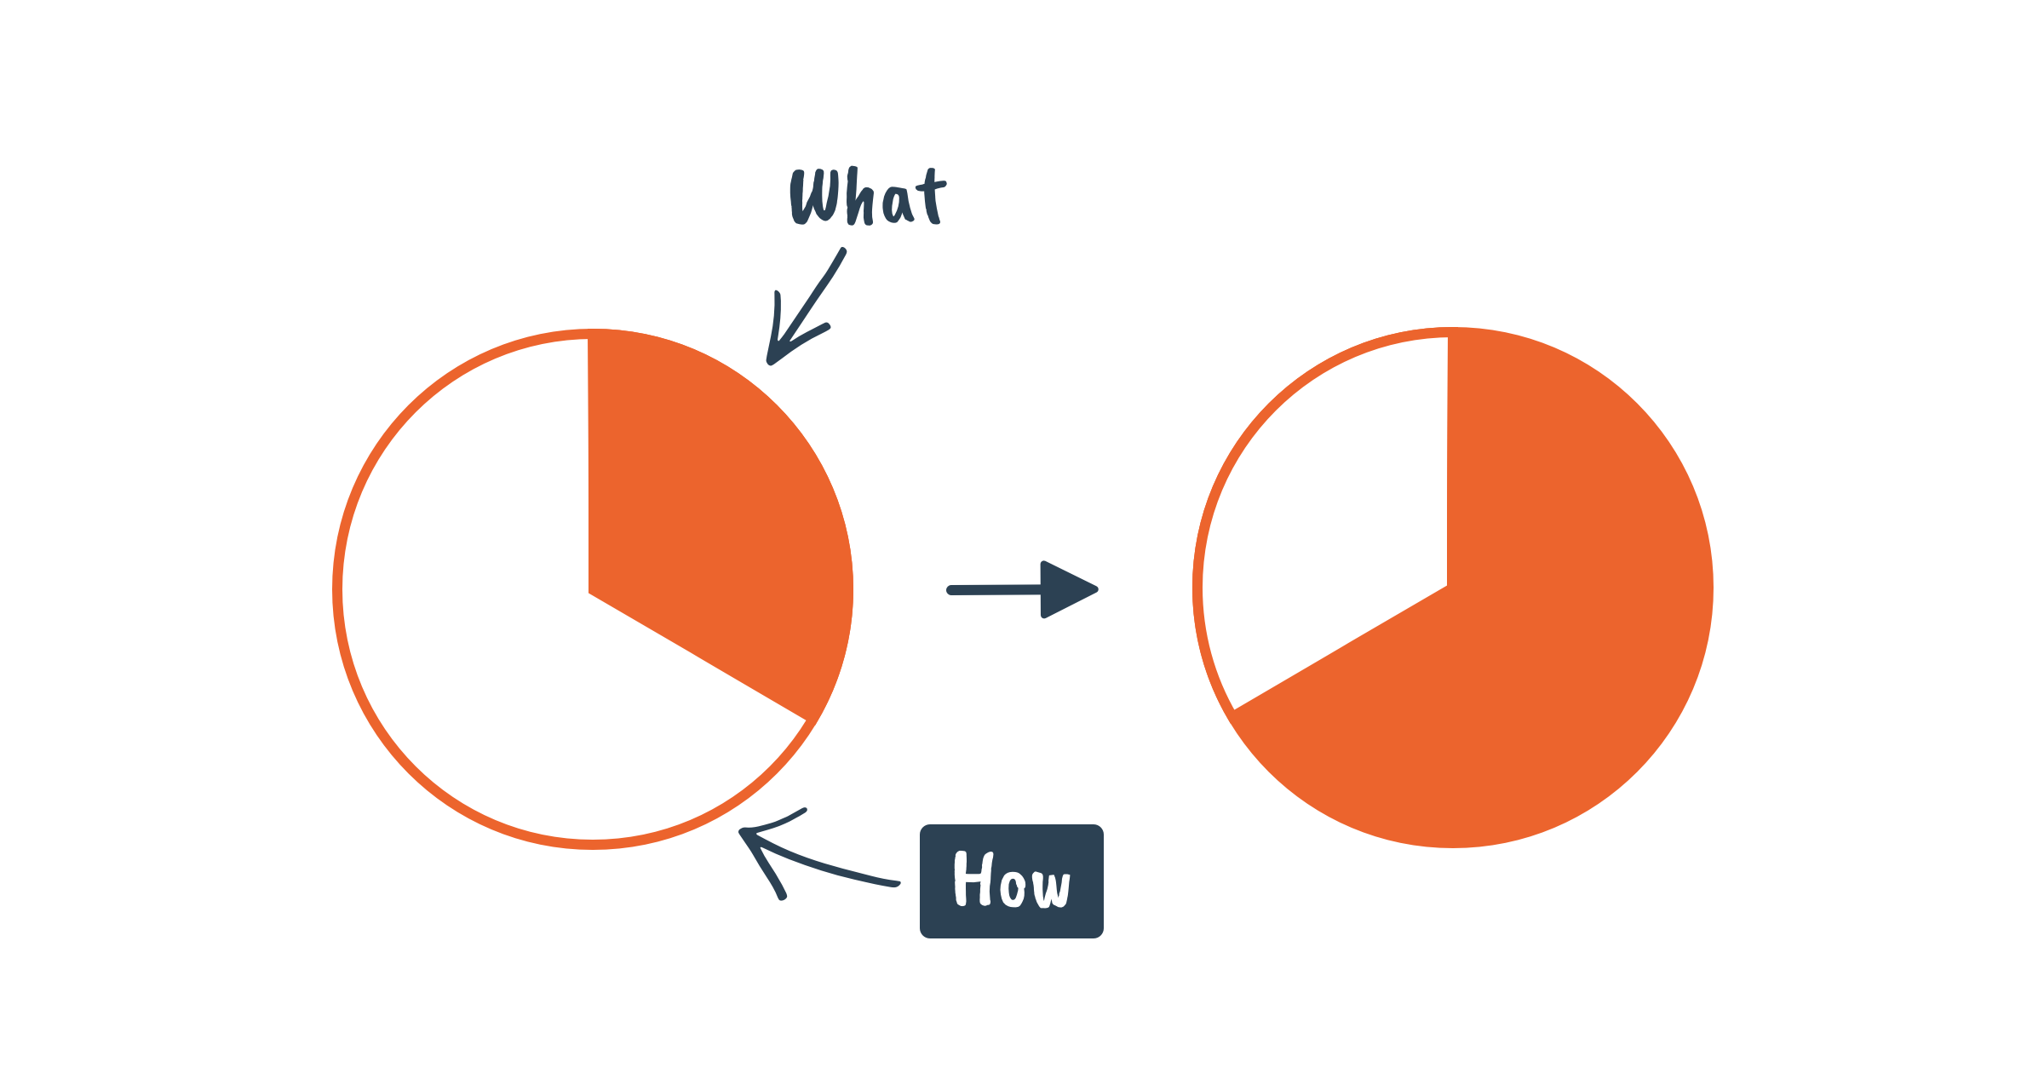

Slide 8
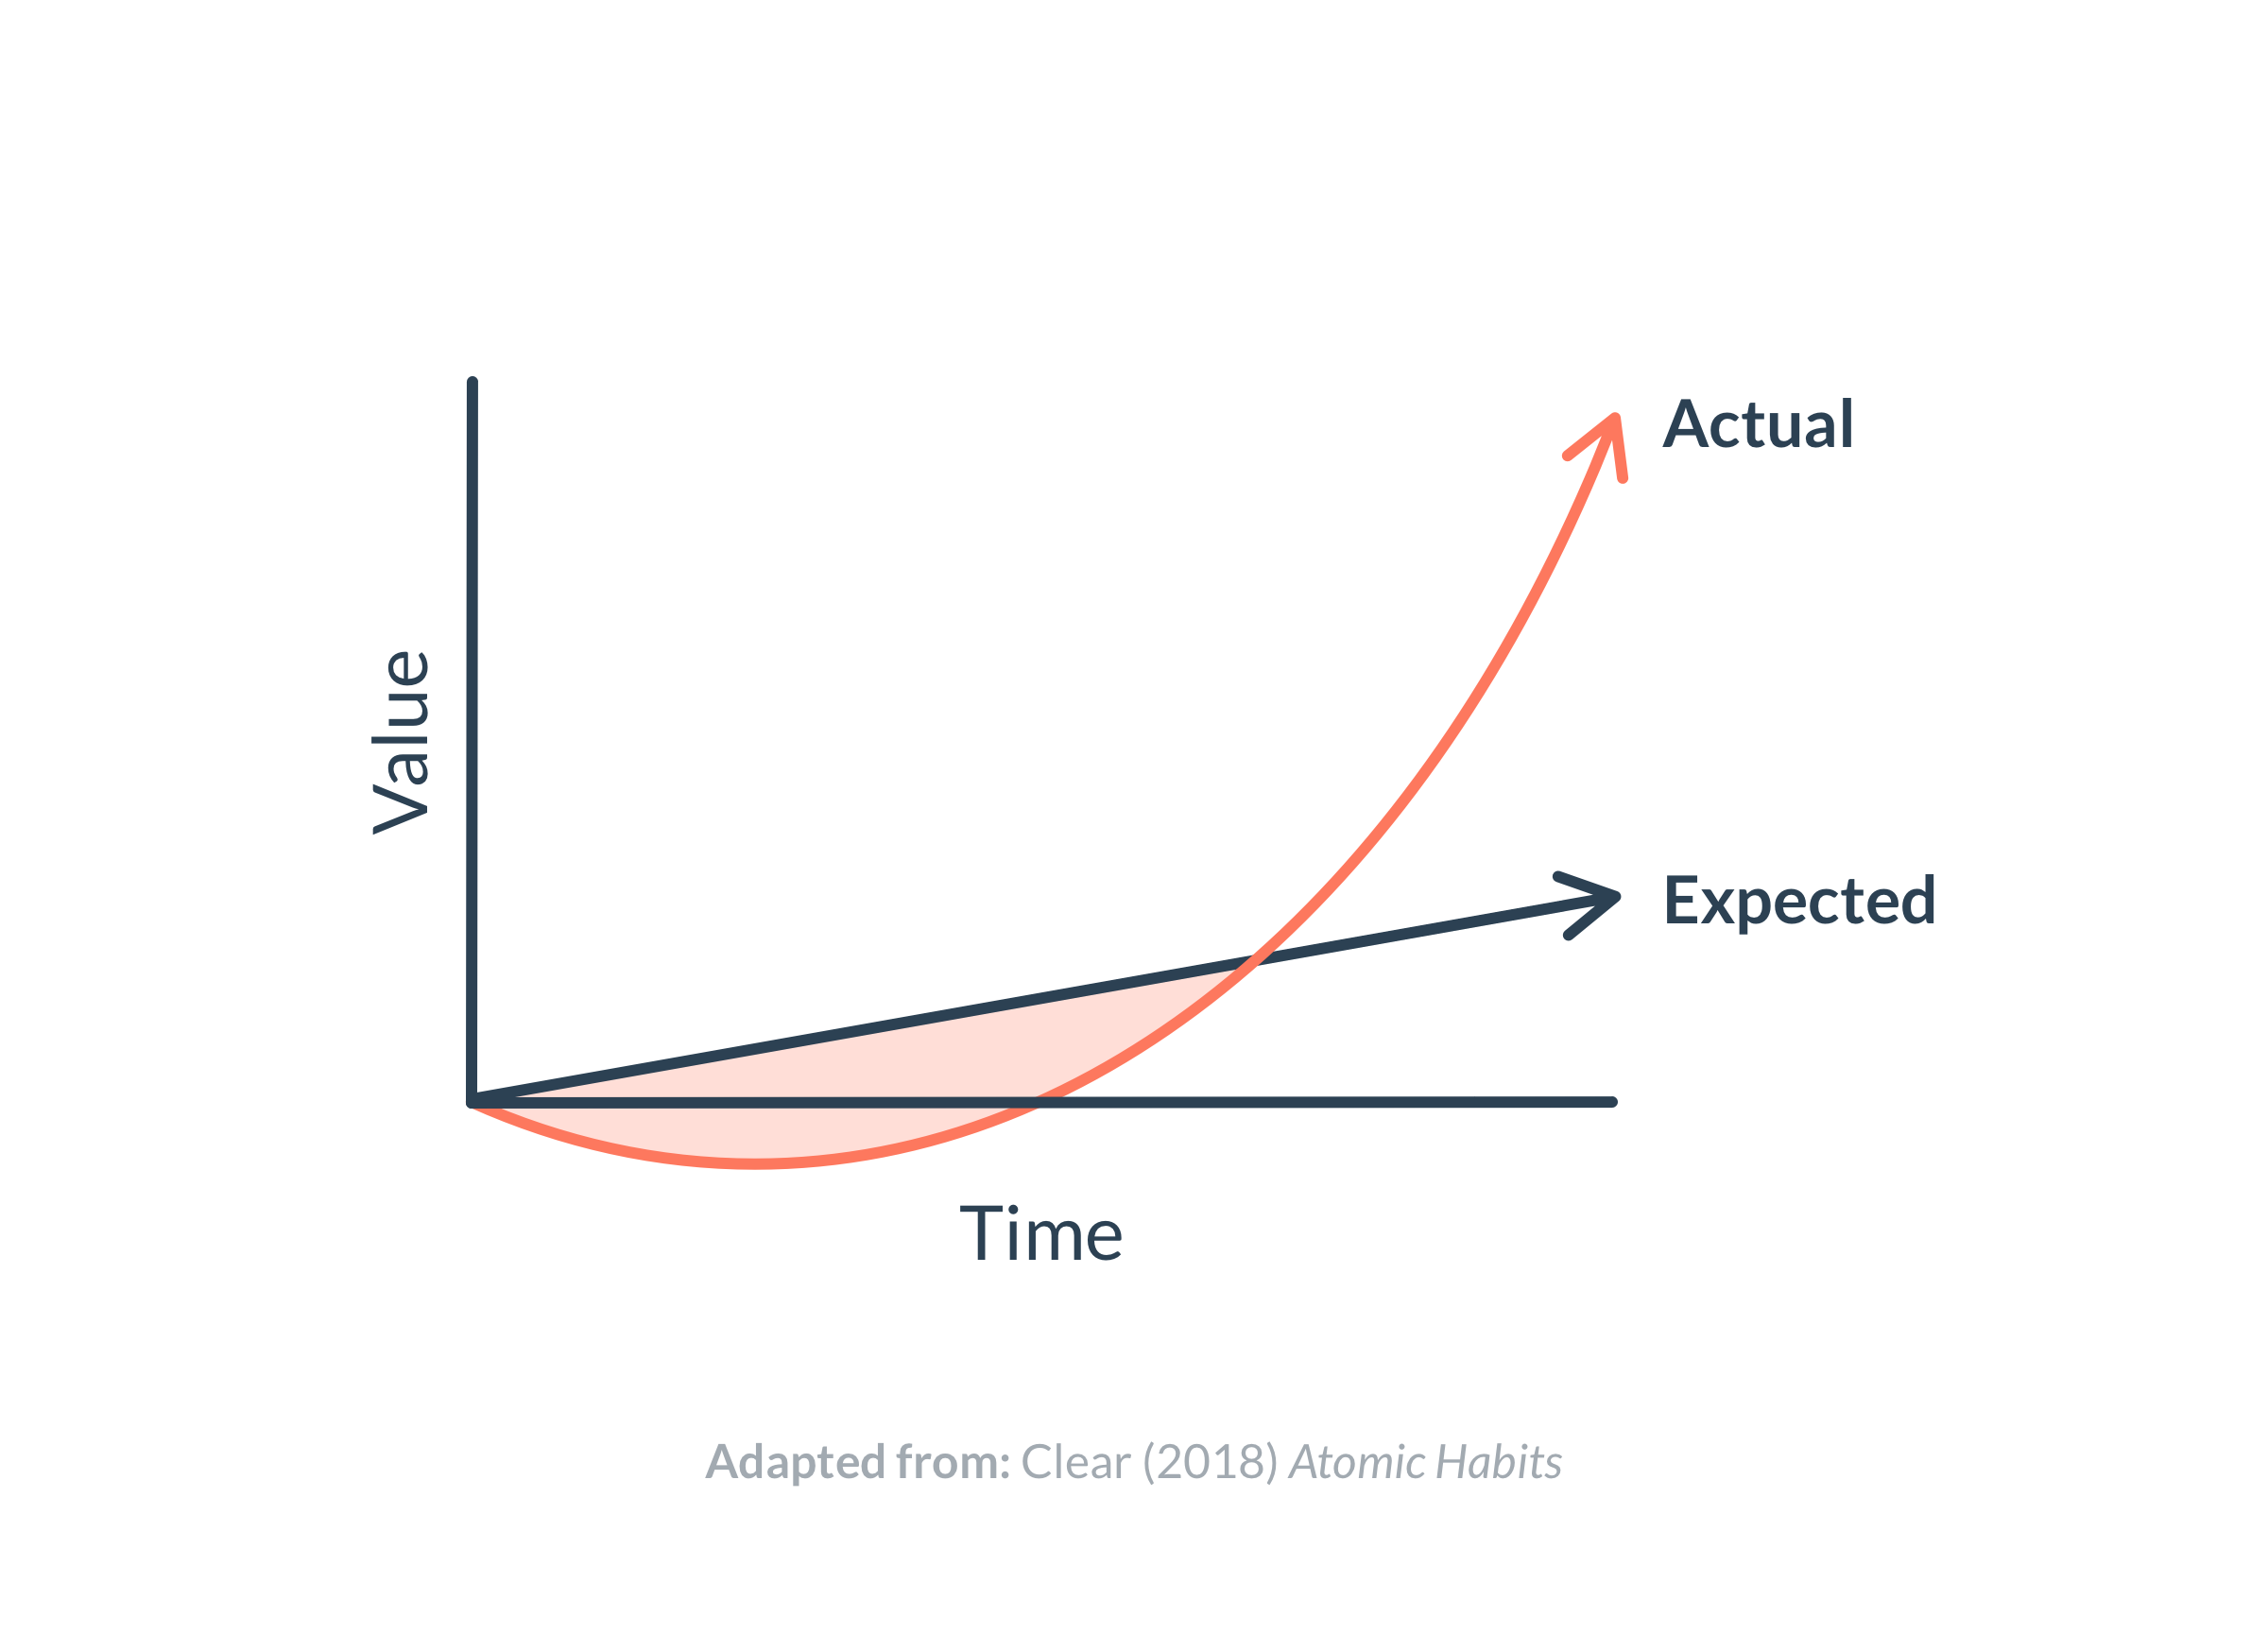

Slide 10


Slide 12


Slide 14
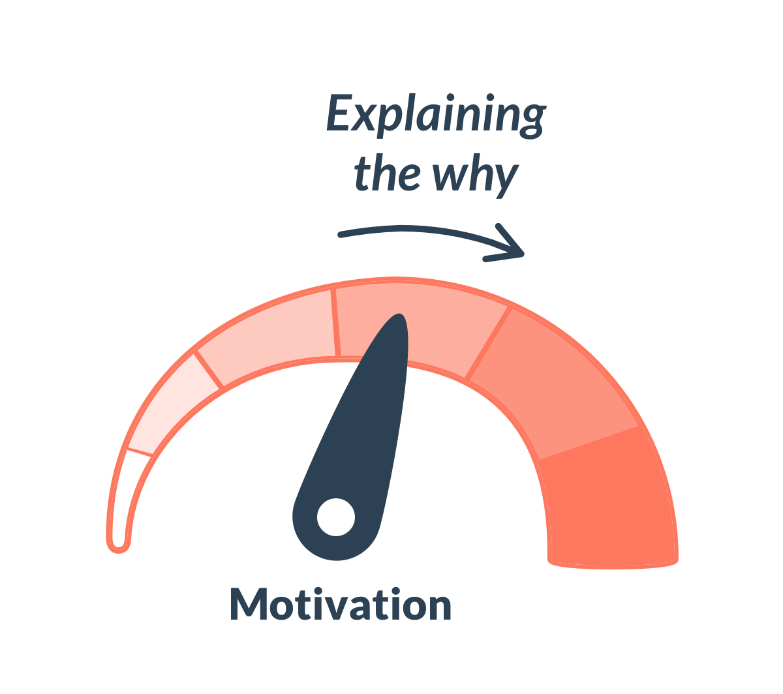

Slide 17



pepsmccrea.com/motivation

Slide 18


pepsmccrea.com/snacks

Slide 19
Peps
Mccrea
@pepsmccrea

