Slide 1
Understanding and developing teacher expertise: an evidence-based approach
Prof Rob Coe, Evidence Based Education
Bryanston Education Summit, June 2023

Slide 2
Outline
What kind of teacher expertise matters?
How do we build expertise?

Slide 3
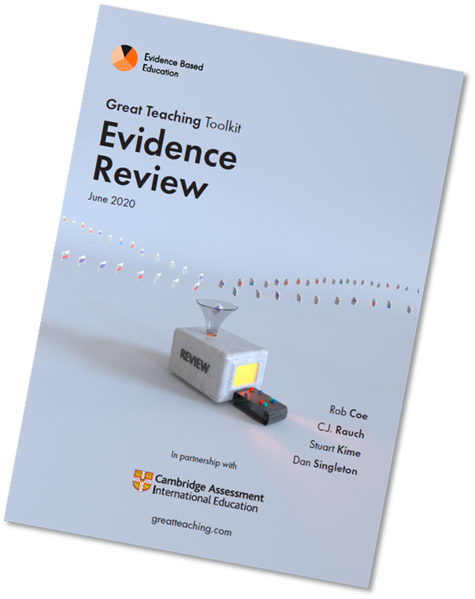
What makes most difference to how much students learn?
“Raising the quality of teaching within existing schools is probably the single most effective thing we could do to promote both overall attainment and equity”
(Coe et al, 2020)
Quality Teaching
greatteaching.com
Notes:
Biggest impact is from helping every teacher to be a little bit better, with every class, every lesson, every day.
Coe, R., Rauch, C.J., Kime, S. and Singleton, D. (2020) Great Teaching Toolkit Evidence Review. Evidence Based Education, in partnership with Cambridge Assessment International Education. greatteaching.com

Slide 4
Teaching is arguably
The hardest job in the world
The most important job in the world
Shulman (1987); Hanushek & Woessmann (2010); Chetty et al (2014)
Notes:
Hardest:
"...After some 30 years of doing such work, I have concluded that classroom teaching - particularly at the elementary and secondary levels - is the most demanding, subtle, nuanced, and frightening activity our species has ever invented. In fact, when I compared the complexity of teaching with the much more highly rewarded profession, "doing medicine," I concluded that the only time medicine ever approaches the complexity of an average day for a classroom teacher is in an emergency room during a natural disaster ... When 30 patients want your attention at the same time, only then do you approach the complexity of the average classroom on an average day."
(Shulman, L.S. (1987) The Wisdom of Practice: Managing Complexity in Medicine and Teaching, p369-397).
Most important:
25 point rise in national PISA scores corresponds to £4 trillion boost in GDP
Hanushek E.A. & Woessmann L. (2010) The High Cost of Low Educational Performance: The Long-run Economic Impact
of Improving PISA Outcomes. OECD Programme for International Student Assessment. http://www.oecd.org/dataoecd/11/28/44417824.pdf
“… students assigned to high-VA teachers in primary school are more likely to attend college, earn higher salaries, and are less likely to have children as teenagers. Replacing a teacher whose VA is in the bottom 5% with an average teacher would increase the present value of students' lifetime income by approximately $250,000 per classroom.”
Chetty, R., Friedman, J. N., & Rockoff, J. E. (2014). Measuring the impacts of teachers II: Teacher value-added and student outcomes in adulthood. American Economic Review, 104(9), 2633-79.

Slide 5
What makes a great teacher?
One who is willing to do what it takes to be demonstrably more effective next year than this
Notes:
Is what we currently do good enough? Yes, and no. Yes, because everyone is working hard, doing their best – and achieving great things. No, because we can always be better.
There is no threshold at which performance becomes good enough.
So, our standard should apply to our commitment and direction of travel, not current status.
‘Demonstrably’ indicates need for evidence
‘Next year’ suggests the likely timescale

Slide 6
What kind of teacher expertise matters?

Slide 7
True or False?
Students will only learn from a teacher that they like
There will always be some students who do not succeed, and even the best teacher cannot do much about this
Every lesson should offer differentiation: different materials, tasks and success criteria for different students
Teachers should praise all their students every lesson
For most experienced teachers, improving their management of students’ behaviour is unlikely to increase students’ learning
Every lesson should start with a retrieval quiz to reactivate previous knowledge
Understanding students’ learning styles can give us insights into how best to teach them
Great teachers should always aim to minimise students' cognitive load
When they explain a new idea, teachers should be spontaneous and authentic and improvise, rather than script in detail exactly what they are going to say
Students should spend the majority of their time working independently on realistic problems
https://bit.ly/gttquiz
Notes:
https://forms.office.com/r/LephLi1ELe
https://bit.ly/gttquiz

Slide 8
1 | Students will only learn from a teacher that they like | FALSE: Liking is good, but not essential (2.1)
2 | There will always be some students who do not succeed and even the best teacher cannot do much about this | FALSE: Teachers should have high expectations for every student (2.4)
3 | Every lesson should offer differentiation: different materials, tasks and success criteria for different students | FALSE: Having different success criteria undermines high expectations for all (2.4)
4 | Teachers should praise all their students every lesson | FALSE: Praise for poor work or semi-compliant behaviour undermines high expectations (2.4, 3.3)
5 | For most experienced teachers, improving their management of students’ behaviour is unlikely to increase students’ learning | FALSE - Time on task is one of the strongest predictors of learning, and is more variable (and lower) than most teachers realise (3.1)
6 | Every lesson should start with a retrieval quiz to reactivate previous knowledge | FALSE: Retrieval quizzes can be good, but need not be every lesson (4.5)
7 | Understanding students’ learning styles can give us insights into how best to teach them | FALSE: Differentiating by learning styles is not supported by research (4.1)
8 | Great teachers should always aim to minimise students' cognitive load | FALSE: Optimise load, not minimise (4.2)
9 | When they explain a new idea, teachers should be spontaneous and authentic, and improvise, rather than script in detail exactly what they are going to say. | FALSE - Concise explanations, that have been crafted to focus on minimal key ideas, help to reduce distraction and extraneous material, and so avoid overloading students' working memory (4.2)
10 | Students should spend the majority of their time working independently on realistic problems | FALSE: This works only when sufficient prior knowledge and connections have been established (4.6)

Slide 9
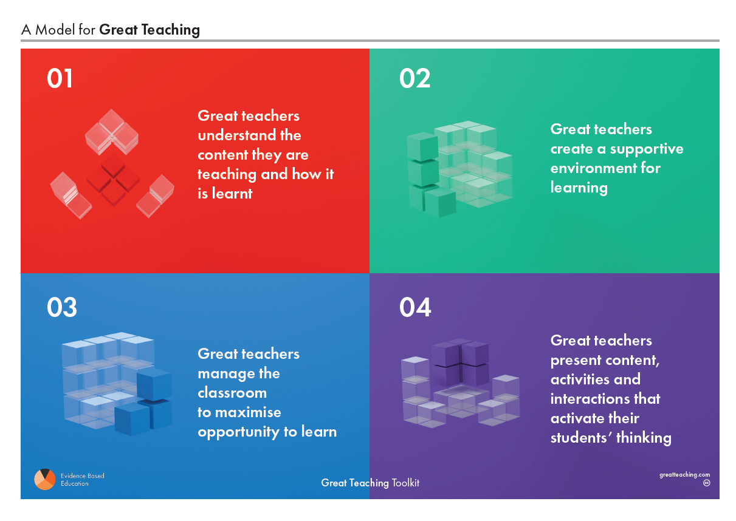
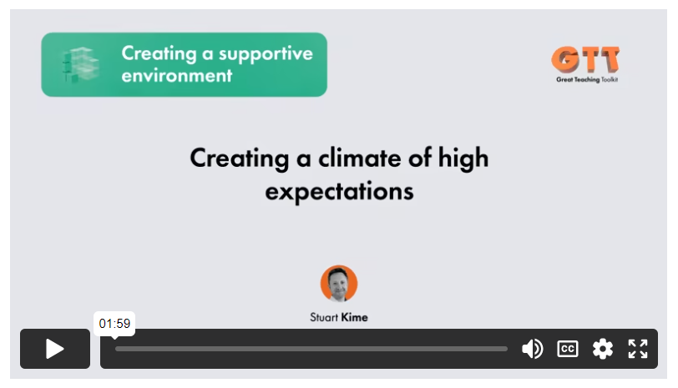
Great Teaching Toolkit: Evidence Review
https://evidencebased.education/great-teaching-toolkit-evidence-review/
Notes:
Coe, R., Rauch, C.J., Kime, S. and Singleton, D. (2020) Great Teaching Toolkit Evidence Review. Evidence Based Education, in partnership with Cambridge Assessment International Education. greatteaching.com

Slide 10
Overview of our model
Great teachers:
01 understand the content they are teaching and how it is learnt
02 create a supportive environment for learning
03 manage the classroom to maximise opportunity to learn
04 present content, activities and interactions that activate their students’ thinking
Notes:
Coe, R., Rauch, C.J., Kime, S. and Singleton, D. (2020) Great Teaching Toolkit Evidence Review. Evidence Based Education, in partnership with Cambridge Assessment International Education. greatteaching.com

Slide 11
Elements of Great Teaching What is worth learning for teachers?
01 Understanding the content
1.1 Deep and fluent content knowledge
1.2 Curriculum knowledge: sequencing
1.3 Knowledge of tasks, assessments, multiple explanations
1.4 Knowledge of student thinking: misconceptions
02 Creating a supportive environment
2.1 Relationships with students, cultural sensitivity
2.2 Student-student relationships & climate
2.3 Promoting learner motivation
2.4 High expectations, challenge and trust
03 Maximising opportunity to learn
3.1 Managing time and resources to maximise productivity
3.2 Clear and consistent rules, expectations, consequences
3.3 Preventing & responding to disruption, showing awareness
04 Activating hard thinking
4.1 Structuring: matching tasks, scaffolding, signalling objectives
4.2 Explaining: presenting & connecting ideas, modelling examples
4.3 Questioning: promoting hard thinking, assessing
4.4 Interacting: giving, receiving and responding to feedback
4.5 Embedding: practising, reinforcing & spacing learning
4.6 Activating: building independence, supporting metacognition
Notes:
Coe, R., Rauch, C.J., Kime, S. and Singleton, D. (2020) Great Teaching Toolkit Evidence Review. Evidence Based Education, in partnership with Cambridge Assessment International Education. greatteaching.com

Slide 12
Classroom teaching takeaways
Teaching is really very complex!
Teaching expertise can be seen as:
Skill: the ability to use a technique effectively, fluently, automatically
Knowledge: the understanding and judgement to know how, when, why and with what to use & adapt it
Understanding the underlying principles and research evidence is a requirement for leading teaching
Just because you
Have been teaching a long time
Are a school leader
It does not follow that you have this understanding

Slide 13
How do we build expertise?

Slide 14
GTT high-level Theory of Change
Teacher wellbeing & job satisfaction
Participation in teacher development cycles
Teacher goals, values, beliefs
Teacher knowledge & skills
Student academic attainment
Teacher behaviours
School leadership and environment
Participation in leadership development cycles
Classroom environments
Student non-academic outcomes
Resilience, self-efficacy, social skills
Student dispositions
Motivation, mindset

Slide 15
Teacher Development Cycles
Focus
Learn
Embed
Get feedback
Embed the change into routine habits
Identify a desired change in practice
Plan
Practise
Learning cycles
Study

Slide 16
Effective CPD: Sims et al (2022) Active ingredients: Insights, Goals, Techniques, and Practice
Motivate Goals: aims, values, beliefs, commitment
Build Understanding: knowledge, theories, insights, wisdom
Develop Skills: techniques, practical abilities
Embed Habits: automatic behaviours, routines, practice
Notes:
Sims, Sam, Harry Fletcher-Wood, Alison O’Mara-Eves, Sarah Cottingham, Claire Stansfield, Josh Goodrich, Jo Van Herwegen, and Jake Anders. (2022). Effective teacher professional development: new theory and a meta-analytic test. (EdWorkingPaper: 22-507). Retrieved from Annenberg Institute at Brown University: https://doi.org/10.26300/rzet-bf74
Original EEF version of the review (with guidance report, posters, etc) is available at
https://educationendowmentfoundation.org.uk/education-evidence/guidance-reports/effective-professional-development

Slide 17
Optimising professional learning: checklist
Motivating Goals
Staff believe they can and should improve
Staff have specific goals for improving teaching
Goals are challenging: beyond comfort zone
Public commitment to those goals
Building Understanding
PL focused on what matters
PL builds understanding and judgement
PL sequenced coherently
PL checks & builds on prior learning
PL presented in small chunks, with application between
PL uses spacing, repetition & retrieval
PL assesses understanding
Developing Skills
PL presents model examples of practice
PL gives explicit guidance on actions
PL gives opportunities to try out and rehearse new approach outside classroom
Staff get actionable feedback from observer(s)
Staff work collaboratively with peers
Embedding Habits
Change becomes routine, automatic
Still doing in 3 weeks?
Still doing in 6 months?
Notes:
https://forms.office.com/r/gnnnfyhskX
https://bit.ly/gttgoodpd

Slide 18
Instruments to define, clarify and operationalise the elements
Student surveys
General screening tool
Detailed focus spotlights
Classroom observation tools
Comparative judgement of video, audio, transcripts
Behavioural metrics
Staff surveys
School climate: environment and leadership
Assessments of teacher knowledge
Subject knowledge and PCK
Situational and behavioural questions
Student learning gains (value-added) by class
From analysis of internal and standardised summative assessments

Slide 19
How does giving teachers feedback about their classrooms help them improve?
By
Giving insights into their classroom
Clarifying what good looks like
Focussing attention on what matters
Showing progress in their professional learning
Diagnosing strengths and areas for development
Feedback turns experience into learning

Slide 20
Confidential feedback, on demand
Only volunteers will get this feedback
Feedback is given only to the person it concerns
School leaders should explicitly rule out any use for accountability, performance management or capability
But we hope teachers will seek it, and share their feedback with trusted colleagues

Slide 21
https://evidencebased.education/school-environment-and-leadership-evidence-review/

Slide 22
School Environment and Leadership Factors (summary) What school-level factors determine classroom learning?
Student supports
Family and community support
Student fundamental needs
Student beliefs and dispositions
Teacher supports
Teacher collaboration
Collective teacher expertise
Professional learning
Curriculum supports
Curriculum goals and demands
Resources and materials
Learning time
Classroom time allocated
Time outside the classroom
Attendance at school
Disruption to timetabled lessons
Management factors
Supportive working relationships
Improvement mindset
Delivery/ implementation
Staffing

Slide 23
Summary
Classroom teaching is the main thing
What supports this?
School leadership and environment
Professional learning
Feedback

Slide 24
Thank you!
rob@evidencebased.education
@ProfCoe @EvidenceInEdu
https://evidencebased.education/

